Slide 1

Operating systems
Lecture # 04

Slide 2
Lecture Overview
Dual-Mode Operation
System Calls in OS
Inter Process Communication (IPC)

Slide 3
Dual-mode operation
Need two separate modes of operation: User Mode and Kernel Mode.
Also called Supervisor Mode & System Mode/Privileged Mode respectively.
A bit, called the mode bit like Kernel (0) or User (1).
With the mode bit, One can distinguish between OS and User mode-based tasks.
When a user application requests a service from the operating system (via a System Call), the system must transition from User to Kernel mode to fulfill the request.

Slide 4
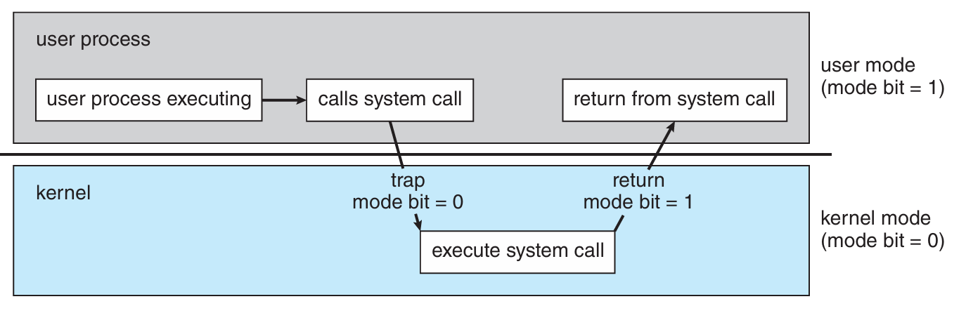
TRANSITION FROM USER TO KERNAL MODE IN OS
Quick Question!
Kernal vs User Mode?
Any Example?

Slide 5
Dual-mode operation
At System Boot Time, the hardware starts in kernel mode. The operating system is then loaded and starts user applications in user mode.
Most contemporary Operating Systems—such as Microsoft Windows, Unix, and Linux uses this dual-mode feature and provide greater protection for the operating system.

Slide 6
System calls
System calls provide the means for a user program to ask the operating system to perform tasks reserved for the operating system on the user program’s behalf.
A way for programs to interact with the operating system.
It is the method used by a process to request action by the operating system.
Different System Calls are available in different operating systems like Windows (2000).

Slide 7
Example System calls
Process Control | fork(), exec(), exit(), wait()
File Management | open(), read(), write(), close()
Device Management | ioctl(), read(), write()
Information Maintenance | getpid(), alarm(), sleep()
Communication | pipe(), msgsnd(), socket()
Protection | chmod(), chown(), access()

Slide 8
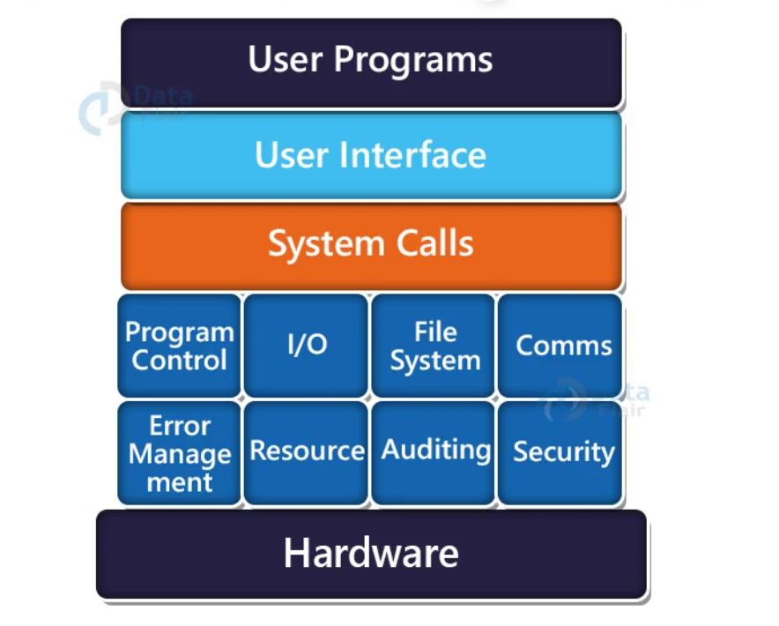

Slide 9
Problems on fork() Fork() always generate child process
Formulas:
2^n
2^n -1

Slide 10
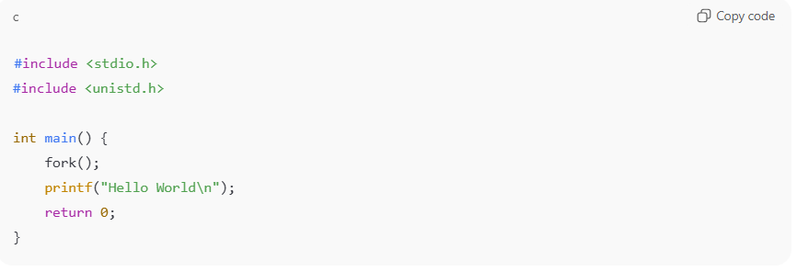
EXAMPLE # 01
Output will be printed 2 times.

Slide 11
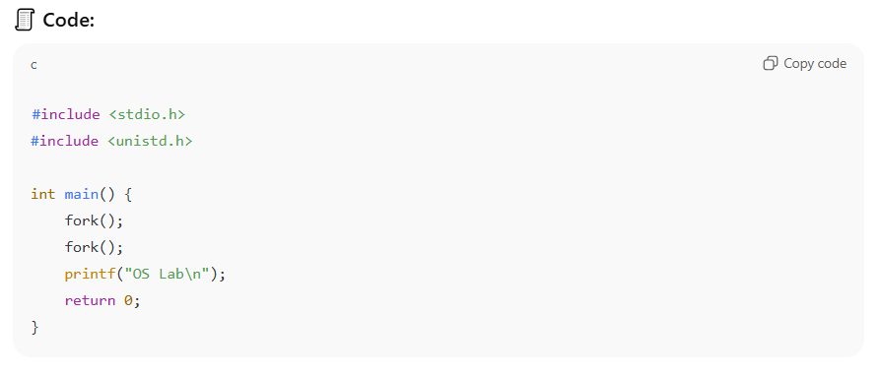
EXAMPLE # 02
Output will be printed 4 times.

Slide 12
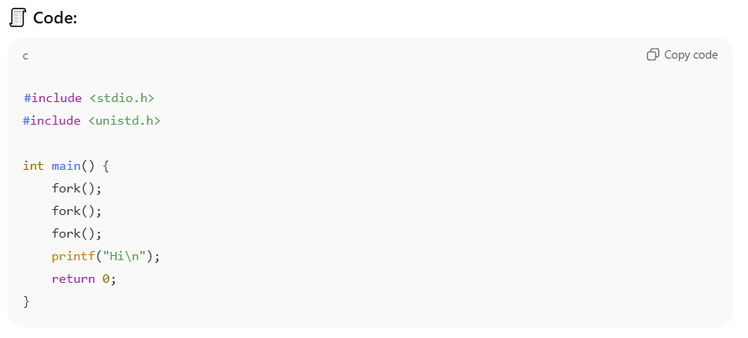
EXAMPLE # 03
How many times will "Hi" be printed?

Slide 13
INTER PROCESS COMMUNICATION (IPC)
A mechanism that allows processes to communicate and synchronize with each other.
Processes executing concurrently in the OS may be either Independent or Cooperating Processes.
Independent - does not share data with any other processes executing in the system.
Cooperating - affect or be affected by the other processes executing in the system.

Slide 14
IPC
There are two fundamental models of interprocess communication
Shared Memory : a region of memory that is shared by the cooperating processes is established.
Message Passing: communication takes place by means of messages exchanged between the cooperating processes.

Slide 15
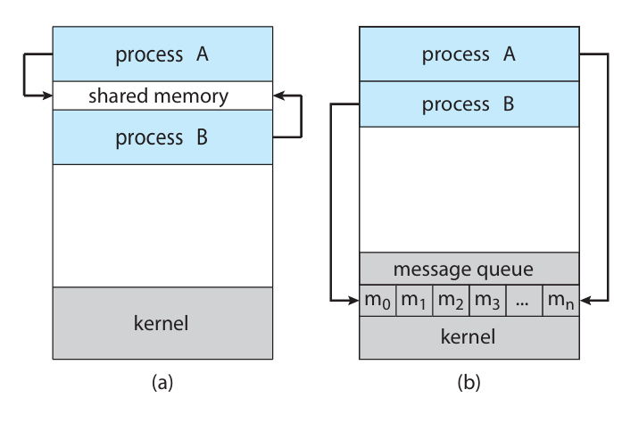
Communications model: (a) Shared memory (b) Message passing

Slide 16
Thank you!
Gratitude turns ordinary moments into blessings!

